Slide 1
Text Mining: Sentiment analysis of Text and Audio
By,
Nikhil Karmude

Slide 2
Data Mining vs. Text Mining
Data Mining
Text Mining
process directly
Identify causal relationship
Structured numeric transaction data residing in rational data warehouse
Linguistic processing or natural language processing (NLP)
Discover heretofore unknown information
Applications deal with much more diverse and eclectic collections of systems and formats

Slide 3
Natural Language Processing
Natural language processing (NLP) is a subfield of artificial intelligence and linguistics. It studies the problems of automated generation and understanding of natural human languages.
Statistical natural language processing uses stochastic, probabilistic and statistical methods to resolve some of the difficulties : e.g. text segmentation, word sense disambiguation
We are using Stanford Core NLP JAVA API

Slide 4
Text Classification: definition
The classifier:
Input: a document x
Output: a predicted class y from some fixed set of labels y₁,...,y_{K}
The learner:
Input: a set of m hand-labeled documents (x₁,y₁),....,(x_{m},y_{m})
Output: a learned classifier f:x → y

Slide 5
Text Classification: Examples
Classify news stories as World, US, Business, SciTech, Sports, Entertainment, Health, Other
Add MeSH terms to Medline abstracts
e.g. “Conscious Sedation” [E03.250]
Classify business names by industry.
Classify student essays as A,B,C,D, or F.
Classify email as Spam, Other.
Classify email to tech staff as Mac, Windows, ..., Other.
Classify pdf files as ResearchPaper, Other
Classify documents as WrittenByReagan, GhostWritten
Classify movie reviews as Favorable,Unfavorable,Neutral.
Classify technical papers as Interesting, Uninteresting.
Classify jokes as Funny, NotFunny.
Classify web sites of companies by Standard Industrial Classification (SIC) code.

Slide 6
Bag of words representation
ARGENTINE 1986/87 GRAIN/OILSEED REGISTRATIONS
BUENOS AIRES, Feb 26
Argentine grain board figures show crop registrations of grains, oilseeds and their products to February 11, in thousands of tonnes, showing those for future shipments month, 1986/87 total and 1985/86 total to February 12, 1986, in brackets:
Bread wheat prev 1,655.8, Feb 872.0, March 164.6, total 2,692.4 (4,161.0).
Maize Mar 48.0, total 48.0 (nil).
Sorghum nil (nil)
Oilseed export registrations were:
Sunflowerseed total 15.0 (7.9)
Soybean May 20.0, total 20.0 (nil)
The board also detailed export registrations for subproducts, as follows....
Categories: grain, wheat

Slide 7
Bag of words representation
xxxxxxxxxxxxxxxxxxx GRAIN/OILSEED xxxxxxxxxxxxx
xxxxxxxxxxxxxxxxxxxxxxx
xxxxxxxxx grain xxxxxxxxxxxxxxxxxxxxxxxxxxxxxxxx grains, oilseeds xxxxxxxxxx xxxxxxxxxxxxxxxxxxxxxxxxxxx tonnes, xxxxxxxxxxxxxxxxx shipments xxxxxxxxxxxx total xxxxxxxxx total xxxxxxxx xxxxxxxxxxxxxxxxxxxx:
Xxxxx wheat xxxxxxxxxxxxxxxxxxxxxxxxxxxxxxxx, total xxxxxxxxxxxxxxxx
Maize xxxxxxxxxxxxxxxxx
Sorghum xxxxxxxxxx
Oilseed xxxxxxxxxxxxxxxxxxxxx
Sunflowerseed xxxxxxxxxxxxxx
Soybean xxxxxxxxxxxxxxxxxxxxxx
xxxxxxxxxxxxxxxxxxxxxxxxxxxxxxxxxxxxxxxxxxxxxxxxxxx....
Categories: grain, wheat

Slide 8
Bag of words representation
word
freq
xxxxxxxxxxxxxxxxxxx GRAIN/OILSEED xxxxxxxxxxxxx
xxxxxxxxxxxxxxxxxxxxxxx
xxxxxxxxx grain xxxxxxxxxxxxxxxxxxxxxxxxxxxxxxxx grains, oilseeds xxxxxxxxxx xxxxxxxxxxxxxxxxxxxxxxxxxxx tonnes, xxxxxxxxxxxxxxxxx shipments xxxxxxxxxxxx total xxxxxxxxx total xxxxxxxx xxxxxxxxxxxxxxxxxxxx:
Xxxxx wheat xxxxxxxxxxxxxxxxxxxxxxxxxxxxxxxx, total xxxxxxxxxxxxxxxx
Maize xxxxxxxxxxxxxxxxx
Sorghum xxxxxxxxxx
Oilseed xxxxxxxxxxxxxxxxxxxxx
Sunflowerseed xxxxxxxxxxxxxx
Soybean xxxxxxxxxxxxxxxxxxxxxx
xxxxxxxxxxxxxxxxxxxxxxxxxxxxxxxxxxxxxxxxxxxxxxxxxxx....
grain(s) | 3
oilseed(s) | 2
total | 3
wheat | 1
maize | 1
soybean | 1
tonnes | 1
... | ...
Categories: grain, wheat

Slide 9
Text Classification with Naive Bayes
Putting this together:
for each document x_{i} with label y_{i}
for each word w_{ij} in x_{i}
count[w_{ij}][y_{i}]++
count[y_{i}]++
count++
to classify a new x=w₁...w_{n}, pick y with top score:
key point: we only need counts for words that actually appear in x

Slide 10
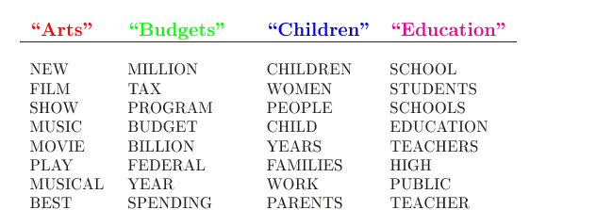
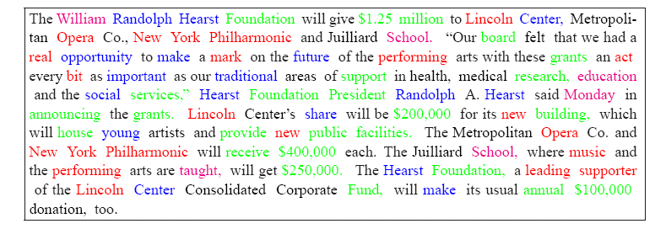
Navies Bayes Model

Slide 11
About Application
We have developed a java application
Input:
Audio (real-time or recorded speech)
Text
Output
Sentiments

Slide 12
Input supported
Text: Document in .pdf or .doc supported
Size: one to two pages
We need to work on algorithm to support huge articles
Sound:
Recorded sound of .wav format are excepted
We can record sound using our application
Google Sound to Text API used using REST full call to Google server by java
Length of audio is limited support 5 to 10 min

Slide 13
Audio based Analysis
We record audio or give a recorded audio to program
Used Google's speech to text API for converting audio in to text
Analyze the text with a product Names
Extract words cause sentiment
Give weights based on positive, negative, sexy, violent, and uncertain.
At the end give aggregated result of whole text.

Slide 14
Text Based Analysis
Give .pdf or word document for analysis
Analyze the document with a brand Names
Extract sentimental words
Give weights based on positive, negative, sexy, violent, and uncertain
At the end give aggregated result of whole text.

Slide 15
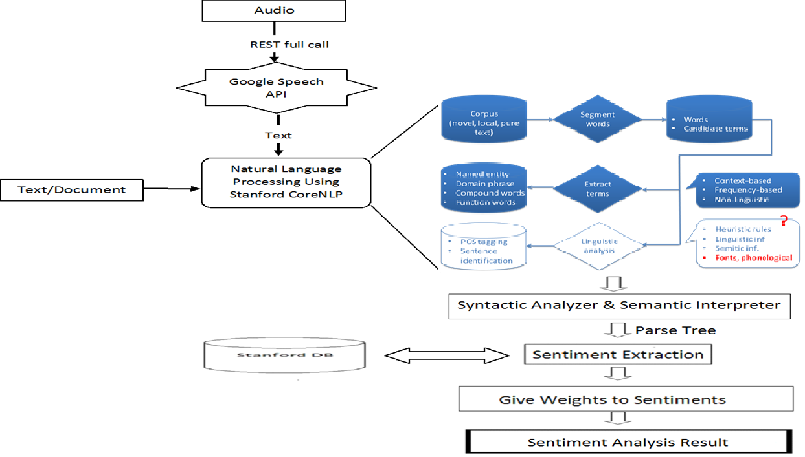
Process
Stanford CoreNLP

Slide 16
Sentiment Extraction
We process text based on brand names
Extract words near to brand names
Number of words should be analyzed before and after the product can be changed
Analyze the output of NLP phase with Stanford DB categorize sentences to 5 type of sentiments by giving weight/score
Used Stanford database for words

Slide 17
User Interface

Slide 18
Results
Input text into the program and run a sentiment analysis for brands mentioned in it.
OR
Record one of the author’s reading the text aloud, and input it into the program.
Compare the sentiment scores of the text or the audio file.
Compare the sentiment scores to the content.

Slide 19
Overall Result

Slide 20
Results

Slide 21
Thank You…

Slide 22
References
[1] B.H. Juang & Lawrence R. Rabiner, Automatic Speech Recognition A Brief History of the Technology Development. Georgia Institute of Technology, Atlanta Rutgers Uni- versity and the University of California, Santa Barbara
[2] Rabiner, Lawrence R. A tutorial on hidden Markov models and selected applications in speech recognition. Proceedings of the IEEE 77.2, pp. 257-286 1989.
[3] Peter Turney, Thumbs Up or Thumbs Down? Semantic Orientation Applied to Unsupervised Classication of Reviews, Proceedings of the Association for Computational Linguistics, pp. 417-424 2002.
[4] Bo Pang; Lillian Lee and Shivakumar Vaithyanathan, Thumbs up? Sentiment Classication using Machine Learning Techniques, Proceedings of the Conference on Em-pirical Methods in Natural Language Processing (EMNLP). pp. 79-86, 2002.
[5] Shanahan, James G., Yan Qu, and Janyce Wiebe, eds. Computing attitude and extracting text: theory and applications. Springer, Vol. 20. 2006.

